Slide 1
Deep Learning-Based Neural Distinguisher for
Format-Preserving Encryption Scheme FF3

Slide 2
Contents
Introduction
Background
Proposed technique
Result

Slide 3
Introduction
Cryptographic algorithms have certain differential properties with certain probabilities
A discriminator attack is the task of distinguishing between password data and random data based on this fact.
Deep learning technology, which performs probabilistic predictions on data, can be a good solution to this.
In this paper, we proposed dividing a deep learning-based neural network for FF3, an Format Preserving Encryption.
Accuracy was tested by inserting several data and rounds using numeric and lowercase alphabet domains.

Slide 4
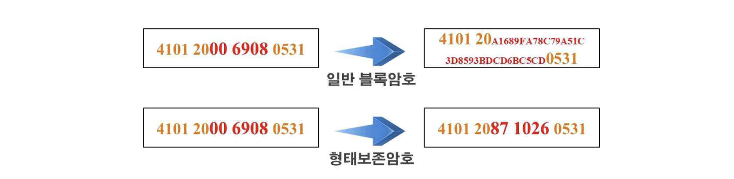
Background(Format Preserving Encryption)
In this paper, ff3, the standard Format Preserving Encryption of the US NIST(National Institute of Standards and Technology)
A Format Preserving Encryption is a cipher that makes the form of the plaintext and ciphertext the same. Here, the form generally refers to the size of the domain.
Format Preserving ciphers are used to encrypt small-size plaintexts. Since the plaintext and ciphertext have the same form, there is no need to store the entire relatively long ciphertext in a general block cipher.
block cipher
Format Preserving Encryption

Slide 5
Background(Artificial Neural Network)
Nodes are connected by weighted connections, and during the learning process, the weights of these connections are adjusted.
Each node is activated through a function, typically determined by the weighted sum of its inputs.
Training involves presenting the network with input-output pairs (training data) and adjusting the weights to minimize the difference between predicted and actual output magnitudes, often performed using backpropagation.
Deep learning involves handling multiple hidden layers in ANNs and finds applications in various fields such as image and speech recognition, natural language processing, recommendation systems, among others.
Notes:
Artificial Neural Networks have played a crucial role in advancing the field of machine learning, contributing to cutting-edge results in tasks requiring pattern recognition and decision-making.

Slide 6
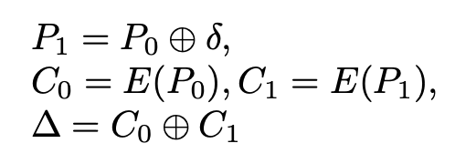
Background(Differential Characteristic)
Differential cryptanalysis is a representative cryptanalysis method of block ciphers. The input difference (δ) is the XOR between the plaintext pairs (P0, P1), and the output difference (∆) is the XOR between the ciphertext pairs.
As in Equation 1, C0 and C1 are the results of encrypting (E) P0 and P1 , respectively.
The output difference (∆) can be obtained by XORing C0 and C1.
In the case of an ideal cipher, when plaintext with any input difference is encrypted, the output difference should be uniform (like random).
A weak cryptographic algorithm has a certain output difference corresponding to an input difference.
If the probability of satisfying an output difference for an input difference is greater than the random probability, the ciphertext can be distinguished from the random.
These characteristics have remained even when encryption is performed and can be inferred probabilistically.
Notes:
XORing C0 and C1 뒤에 설명 → Here, a differential characteristic means a pair of input and output differences (δ, ∆).

Slide 7
Background(Neural Network-based Distinguisher for Differential Cryptanalysis)
Deep learning is a good solution for distinguisher attacks, as it can probabilistically satisfy specific output differences for given input differences.
Consequently, the neural distinguisher performs probabilistic prediction on data applied to distinguisher attacks using differential characteristics.
Most of the ongoing works of neural distinguishers are derived from, and they focus on target ciphers and input differences.
Notes:
XORing C0 and C1 뒤에 설명 → Here, a differential characteristic means a pair of input and output differences (δ, ∆).

Slide 8





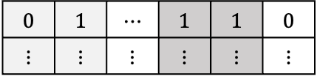







Proposed technique
A discriminator attack utilizes the fact that an encryption algorithm satisfies certain differential characteristics with a certain probability. It is a task of distinguishing password data from random data. In this paper, a solution using deep learning technology was presented.
< FF3’s deep learning-based data set creation process >
First, generate random plaintexts P0 and P1. Since we need to create a plaintext pair that satisfies the input difference, we obtain plaintext P2 by XORing 𝛿 (input difference) with P0.
Afterwards, each plaintext P0, P1, and P2 is encrypted to obtain ciphertexts C0, C1, and C2. Here, C0 and C1 are ciphertexts that encrypt random plaintexts rather than differential relationships, and the result of concatenating the two values is labeled as 0.
Since C0 and C2 are plaintext ciphertexts that satisfy 𝛿 (input difference), they are cipher data that satisfies ∆ (output difference) with a certain probability, so the concatenated value of the two values is labeled as 1.
Random
$⨁$Input difference
$$P0$$
$$P1$$
$$P2(=P0⨁δ)$$
$$C0$$
$$C1 or C2$$
$$Label$$
FF$3$
$$0$$ | $$1$$ | $$⋯$$ | $$1$$ | $$1$$ | $$0$$
$$⋮$$ | $$⋮$$ | $$⋮$$ | $$⋮$$ | $$⋮$$ | $$⋮$$
$$C0$$
$$C1$$
$$C2(=C0⨁Δ)$$
Dataset
Random
$⨁$Output difference

Slide 9
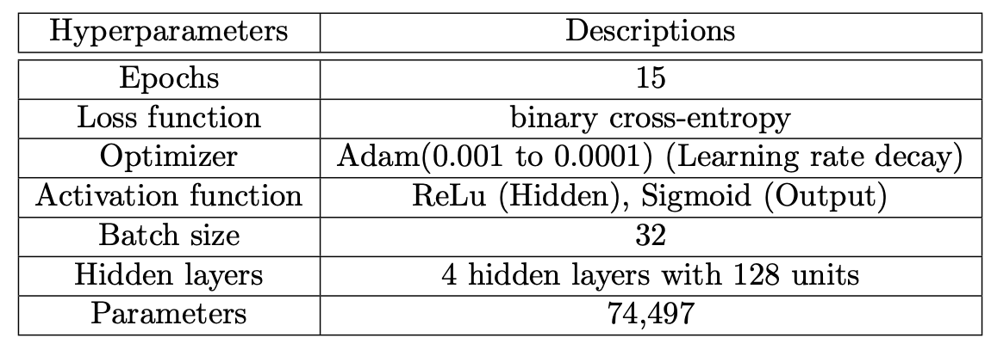







Proposed technique
< Constructing a deep learning-based model in FF3 >
The figure on the right shows the overall structure of the neural network discriminator. Each bit of a random or differential ciphertext pair is assigned to each neuron in the input layer, then passes through a hidden layer and a sigmoid activation function at the output layer to obtain a value between 0 and 1. The loss of that value and the actual correct answer (0 or 1) is calculated.
The table on the right shows the hyperparameters of the discriminator. Epoch is 15 and a Dense layer is used. Since the neural network discriminator must distinguish differential data from random data, binary classification was performed and binary_crossentropy was used as the loss function.
The optimization function uses Adam, which generally has excellent performance, and adjusts the learning rate of the optimization function to reduce the learning rate to 0.001 ~ 0.0001 to perform more sophisticated learning.
$$C0$$
$$C1 or C2$$
$$0$$ | $$1$$ | $$⋯$$ | $$1$$ | $$1$$
$$⋯$$
Input
$$⋮$$
$$⋯$$
Hidden
Output
Random $(0)$ or Cipher $(1)$

Slide 10
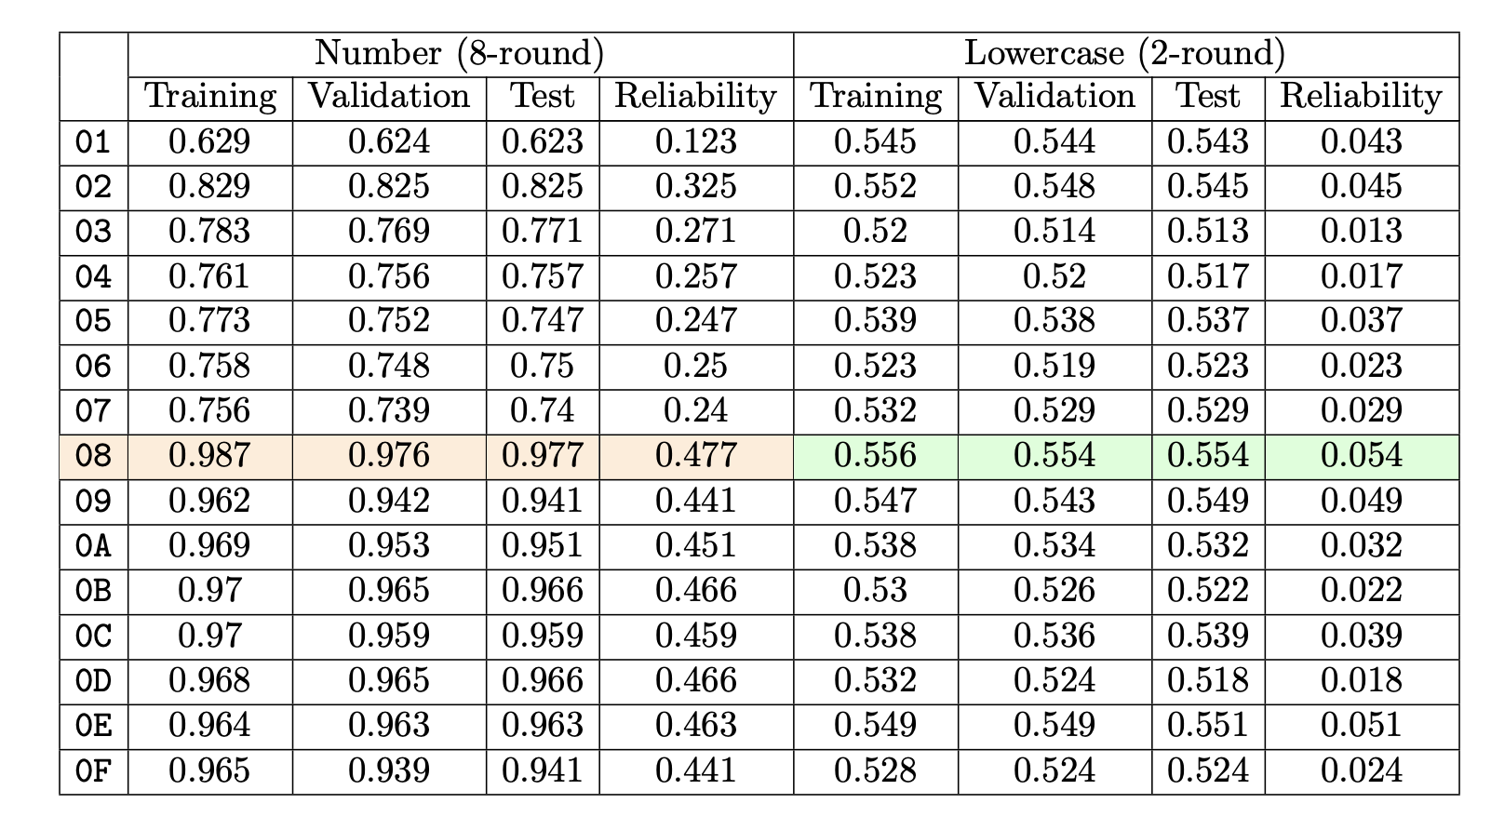
Result
In this paper, the domain of data was divided into numbers (0 ~ 9) and lowercase letters (a ~ z), and using '0x0|K' (K is a hexadecimal number between 0 and F) has a higher difference probability. An experiment was conducted on the presented input differences.
< FF3 deep learning-based discriminator experiment results >
In the case of the digits in the table on the right, when 0x08 was used as the input difference, up to 8 rounds could be distinguished and a high accuracy of 0.98 was achieved. As a result of experiments using other presented input differences, lower accuracy was achieved compared to 0x08.
In the case of the lowercase in the table on the right, as the number of plaintext and ciphertext cases increases to 226, it is possible to distinguish up to 2 rounds, and an accuracy of 0.554 is achieved for the input difference 0x08, and a lower accuracy is achieved for 0x01.
<Result of ModelDistinguisher according to input difference>

Slide 11
Result
< Final conclusion of FF3’s deep learning-based discriminator experiment >
In this paper, we proposed the first deep learning-based neural network discriminator for FF3, a Format Preserving Encryption, and as a result of the experiment, we achieved an accuracy of over 0.98 for 0x08 (input difference) in the numeric domain up to 8 rounds, and in the lowercase letter domain up to 2 rounds. It was possible.
In the future, we plan to implement a neural network discriminator for another Format Preserving Encryption and an FF3 neural network discriminator that can operate in larger domains and high rounds.

